Slide 1



TAZI Mohannad
Mentorness
INDIAN AGRICULTURE
Analysis

Slide 2


Table Of Content
Content List
01.
02.
03.
Problem statement
Dataset Description
EDA
04.
05.
06.
Dashboard
Rapport
Conclusion

Slide 3


Problem statement
Introduction
The objective of this internship project is to perform an in-depth examination of Indian agriculture, emphasizing data categorized by district and year. With a dataset offering intricate details on crop types, cultivation areas, production volumes, and yields spanning multiple districts and years, the aim is to utilize Power BI for crafting interactive visual representations. These visualizations aim to unveil underlying trends, patterns, and discrepancies in agricultural methodologies, empowering stakeholders to make well-informed choices for promoting sustainable farming practices and optimizing resource distribution.

Slide 4

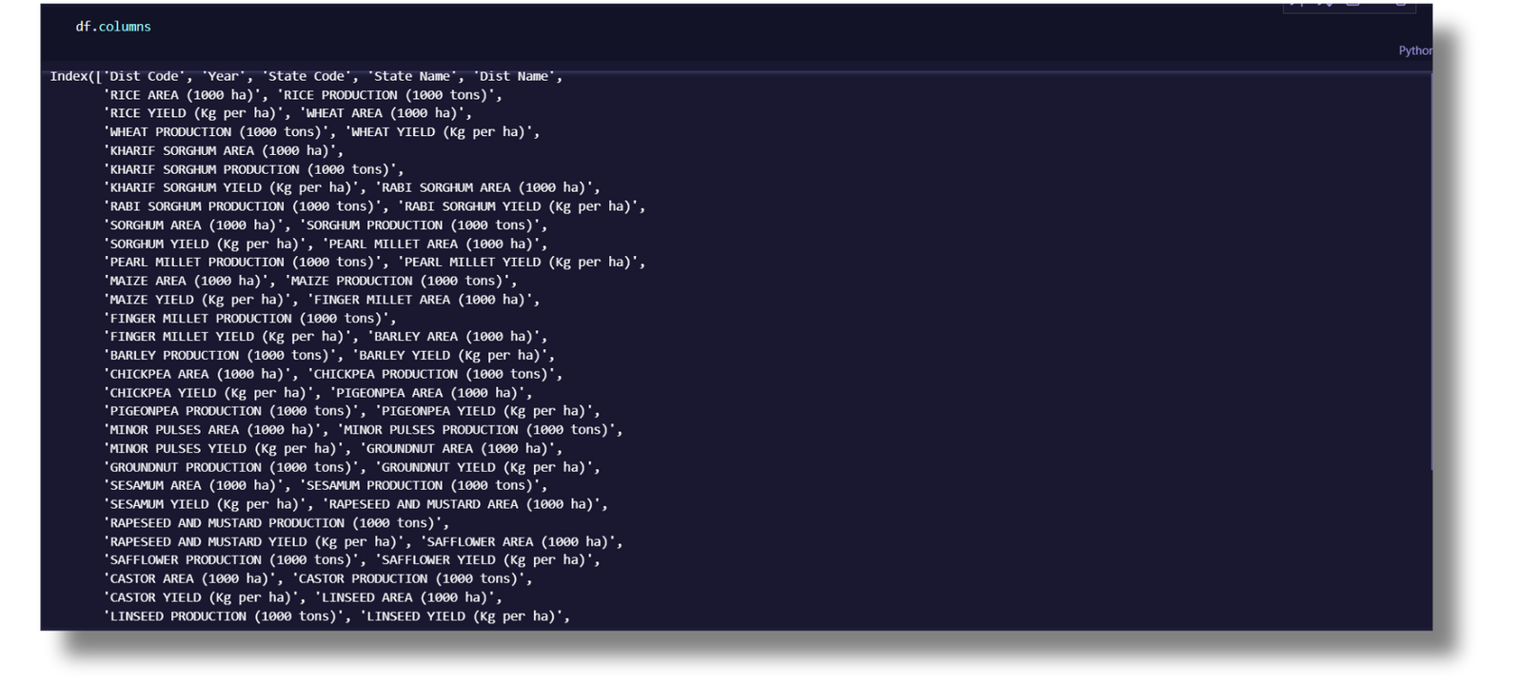
Dataset
Description
The dataset encompasses a wide range of agricultural variables, including crop areas, production quantities, and yields for different crops such as rice, wheat, sorghum, millets, pulses, oilseeds, sugarcane, and more.

Slide 5
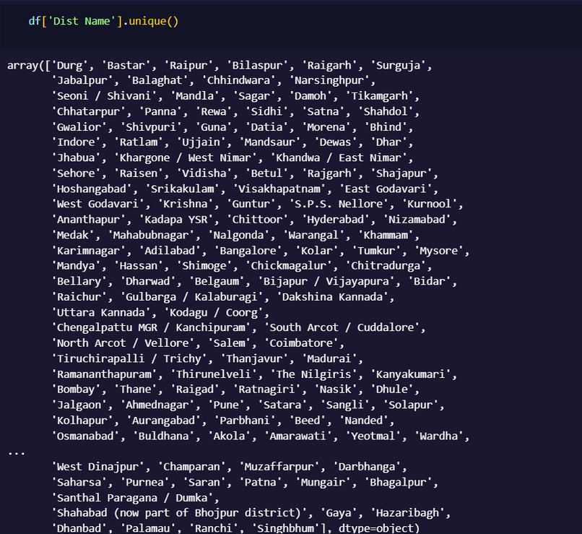
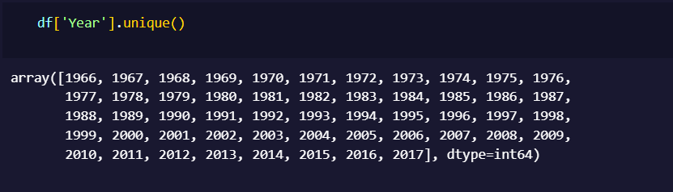
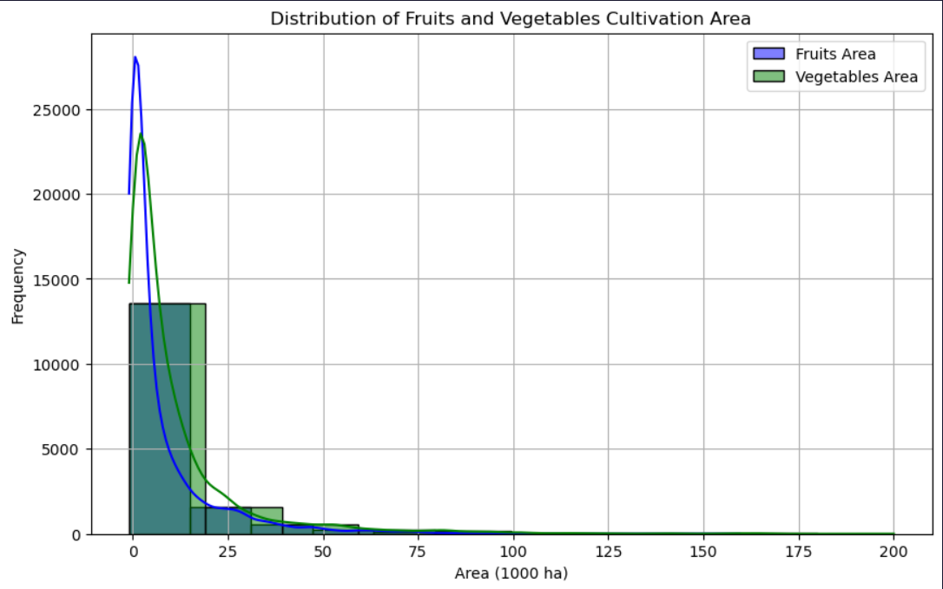
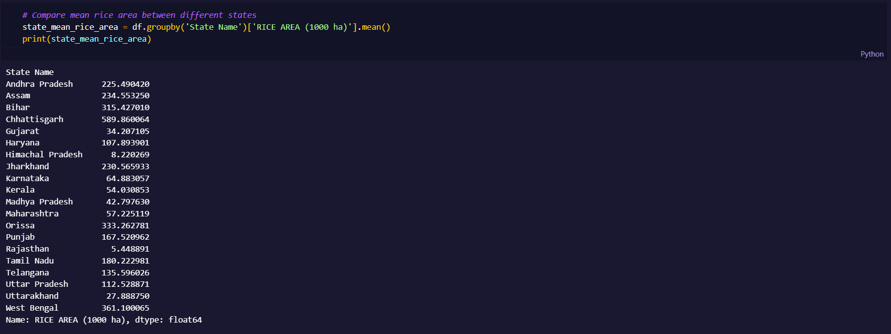
EDA

Slide 6
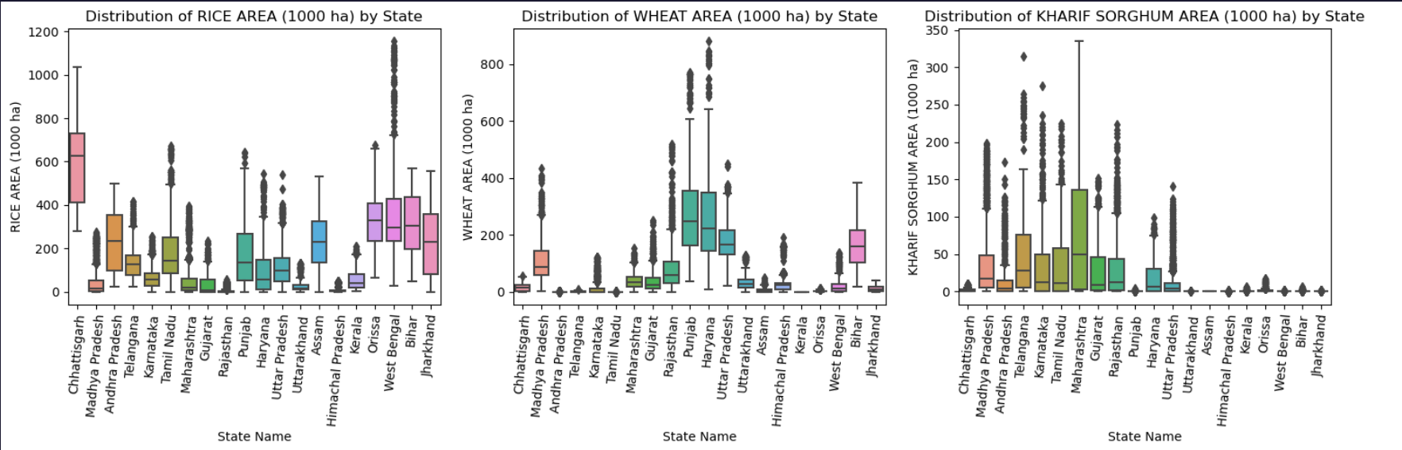
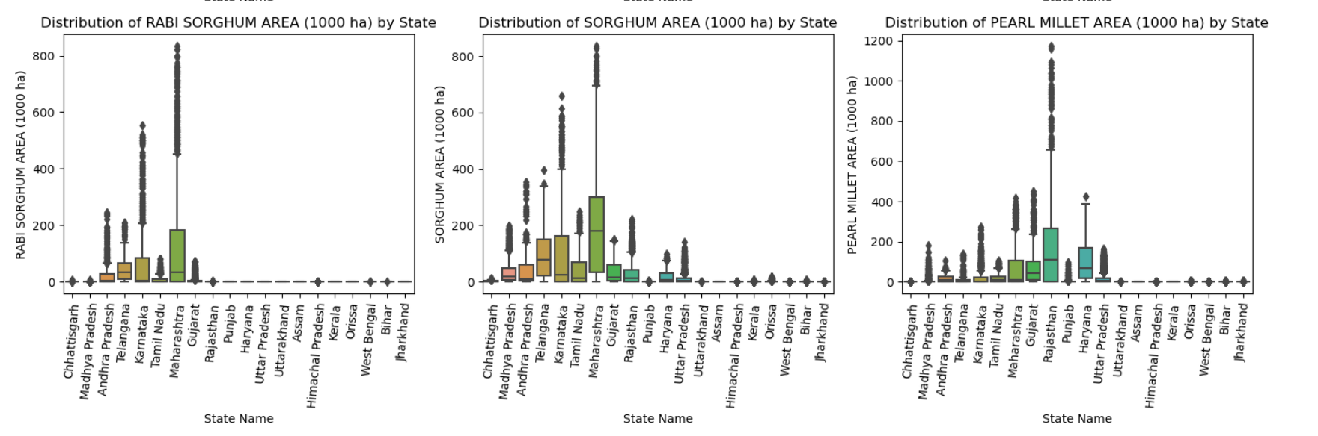
EDA

Slide 7
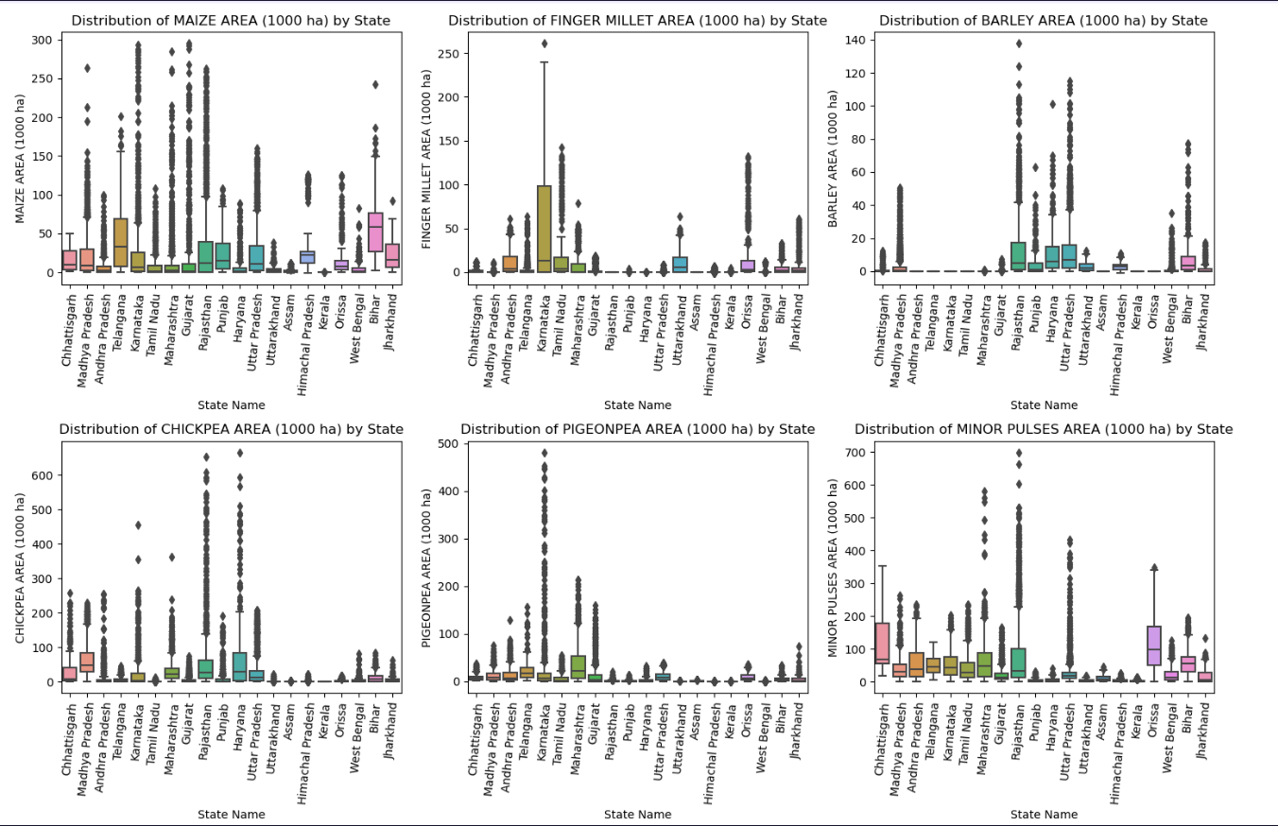
EDA

Slide 8
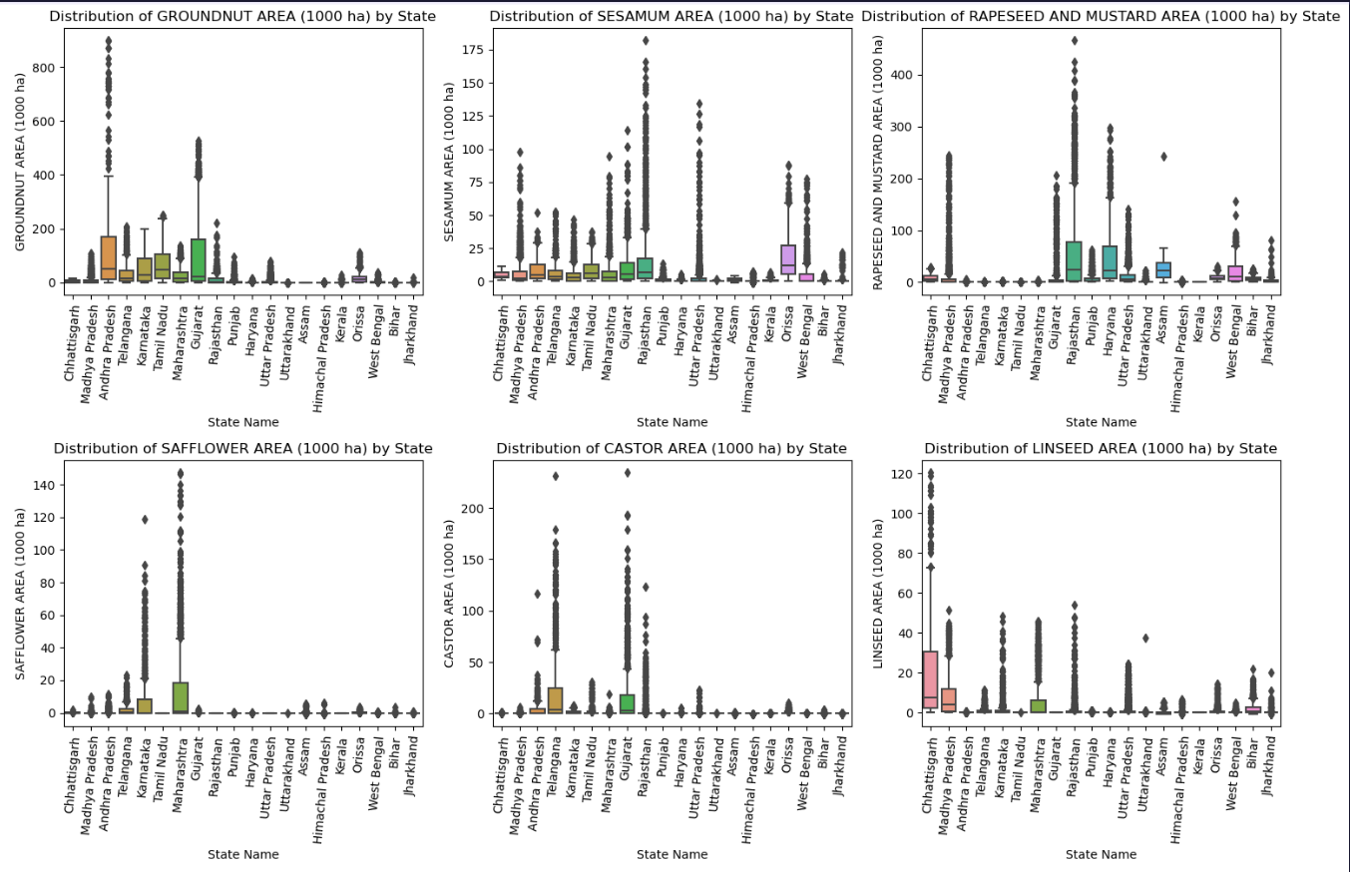
EDA

Slide 9
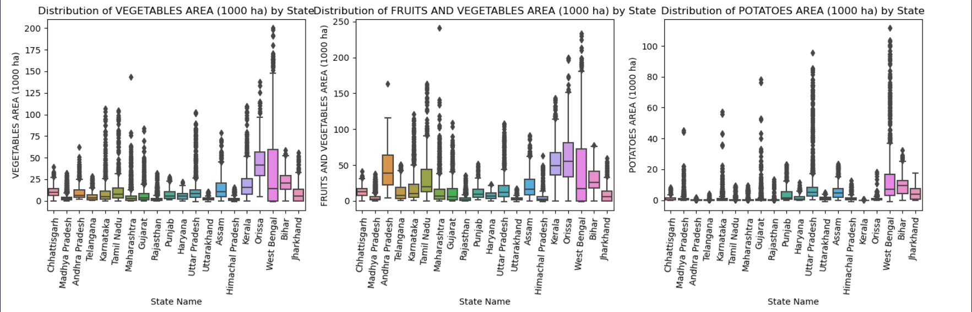
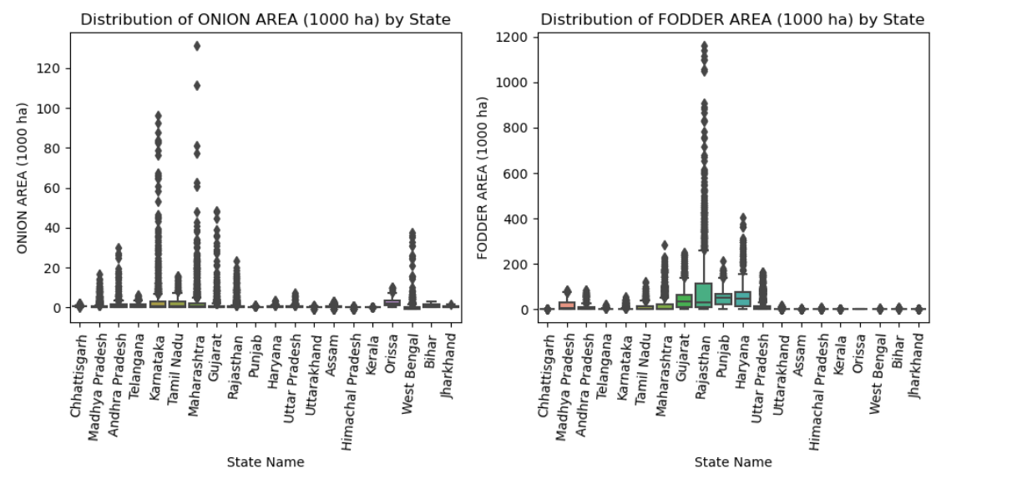
EDA

Slide 10
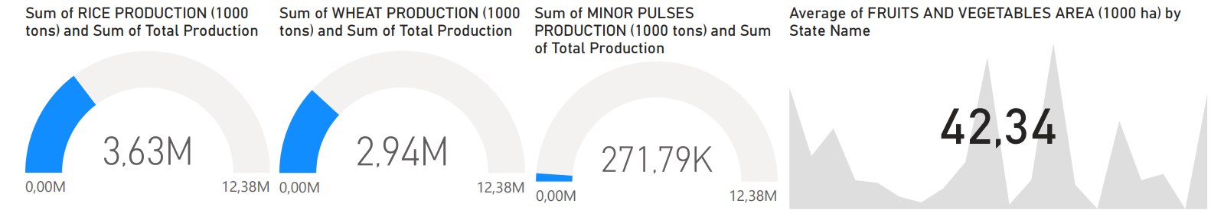
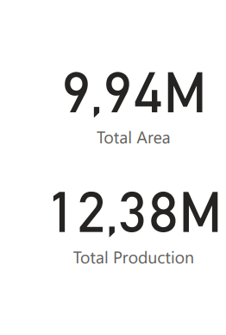
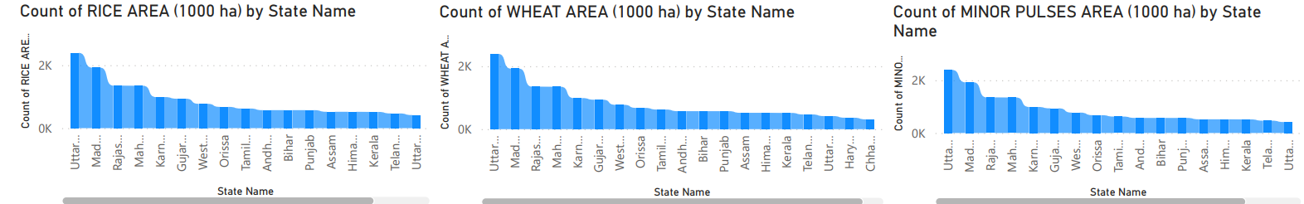
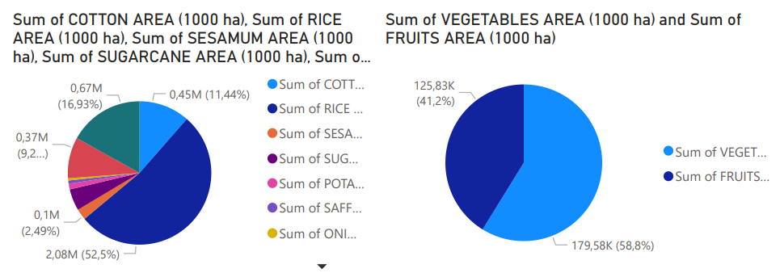

Dashboard

Slide 11
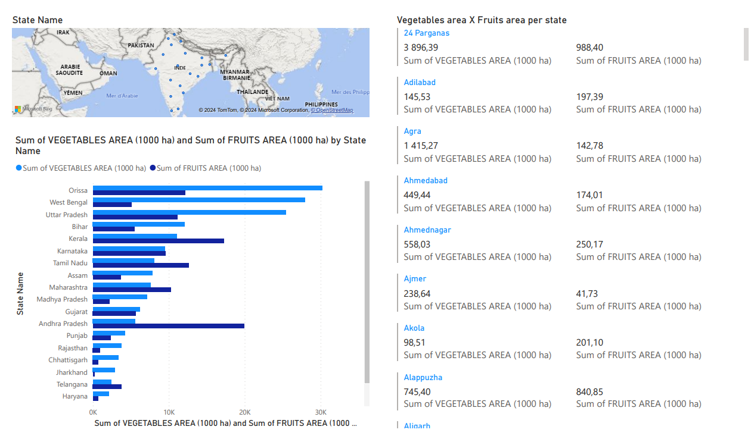
Rapport

Slide 12
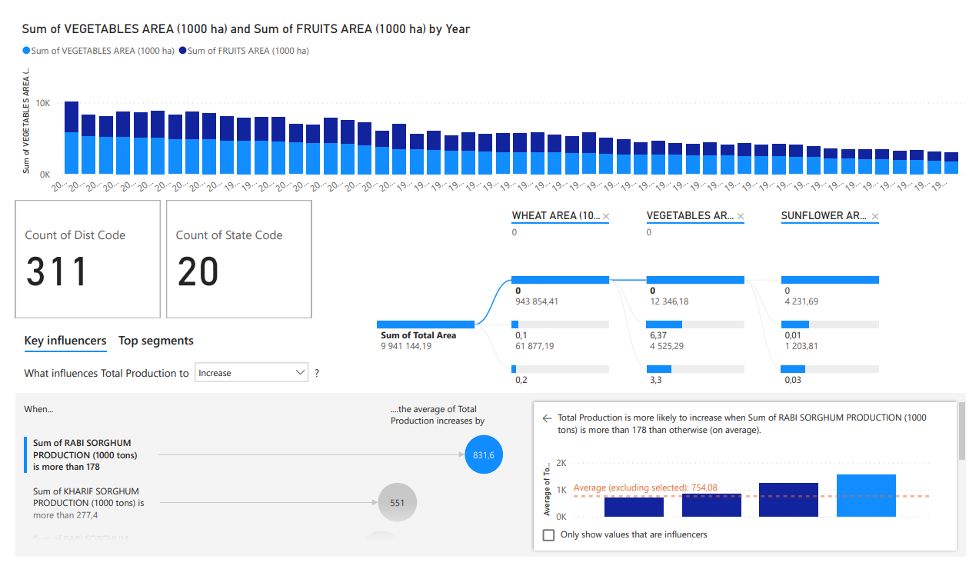
Rapport

Slide 13
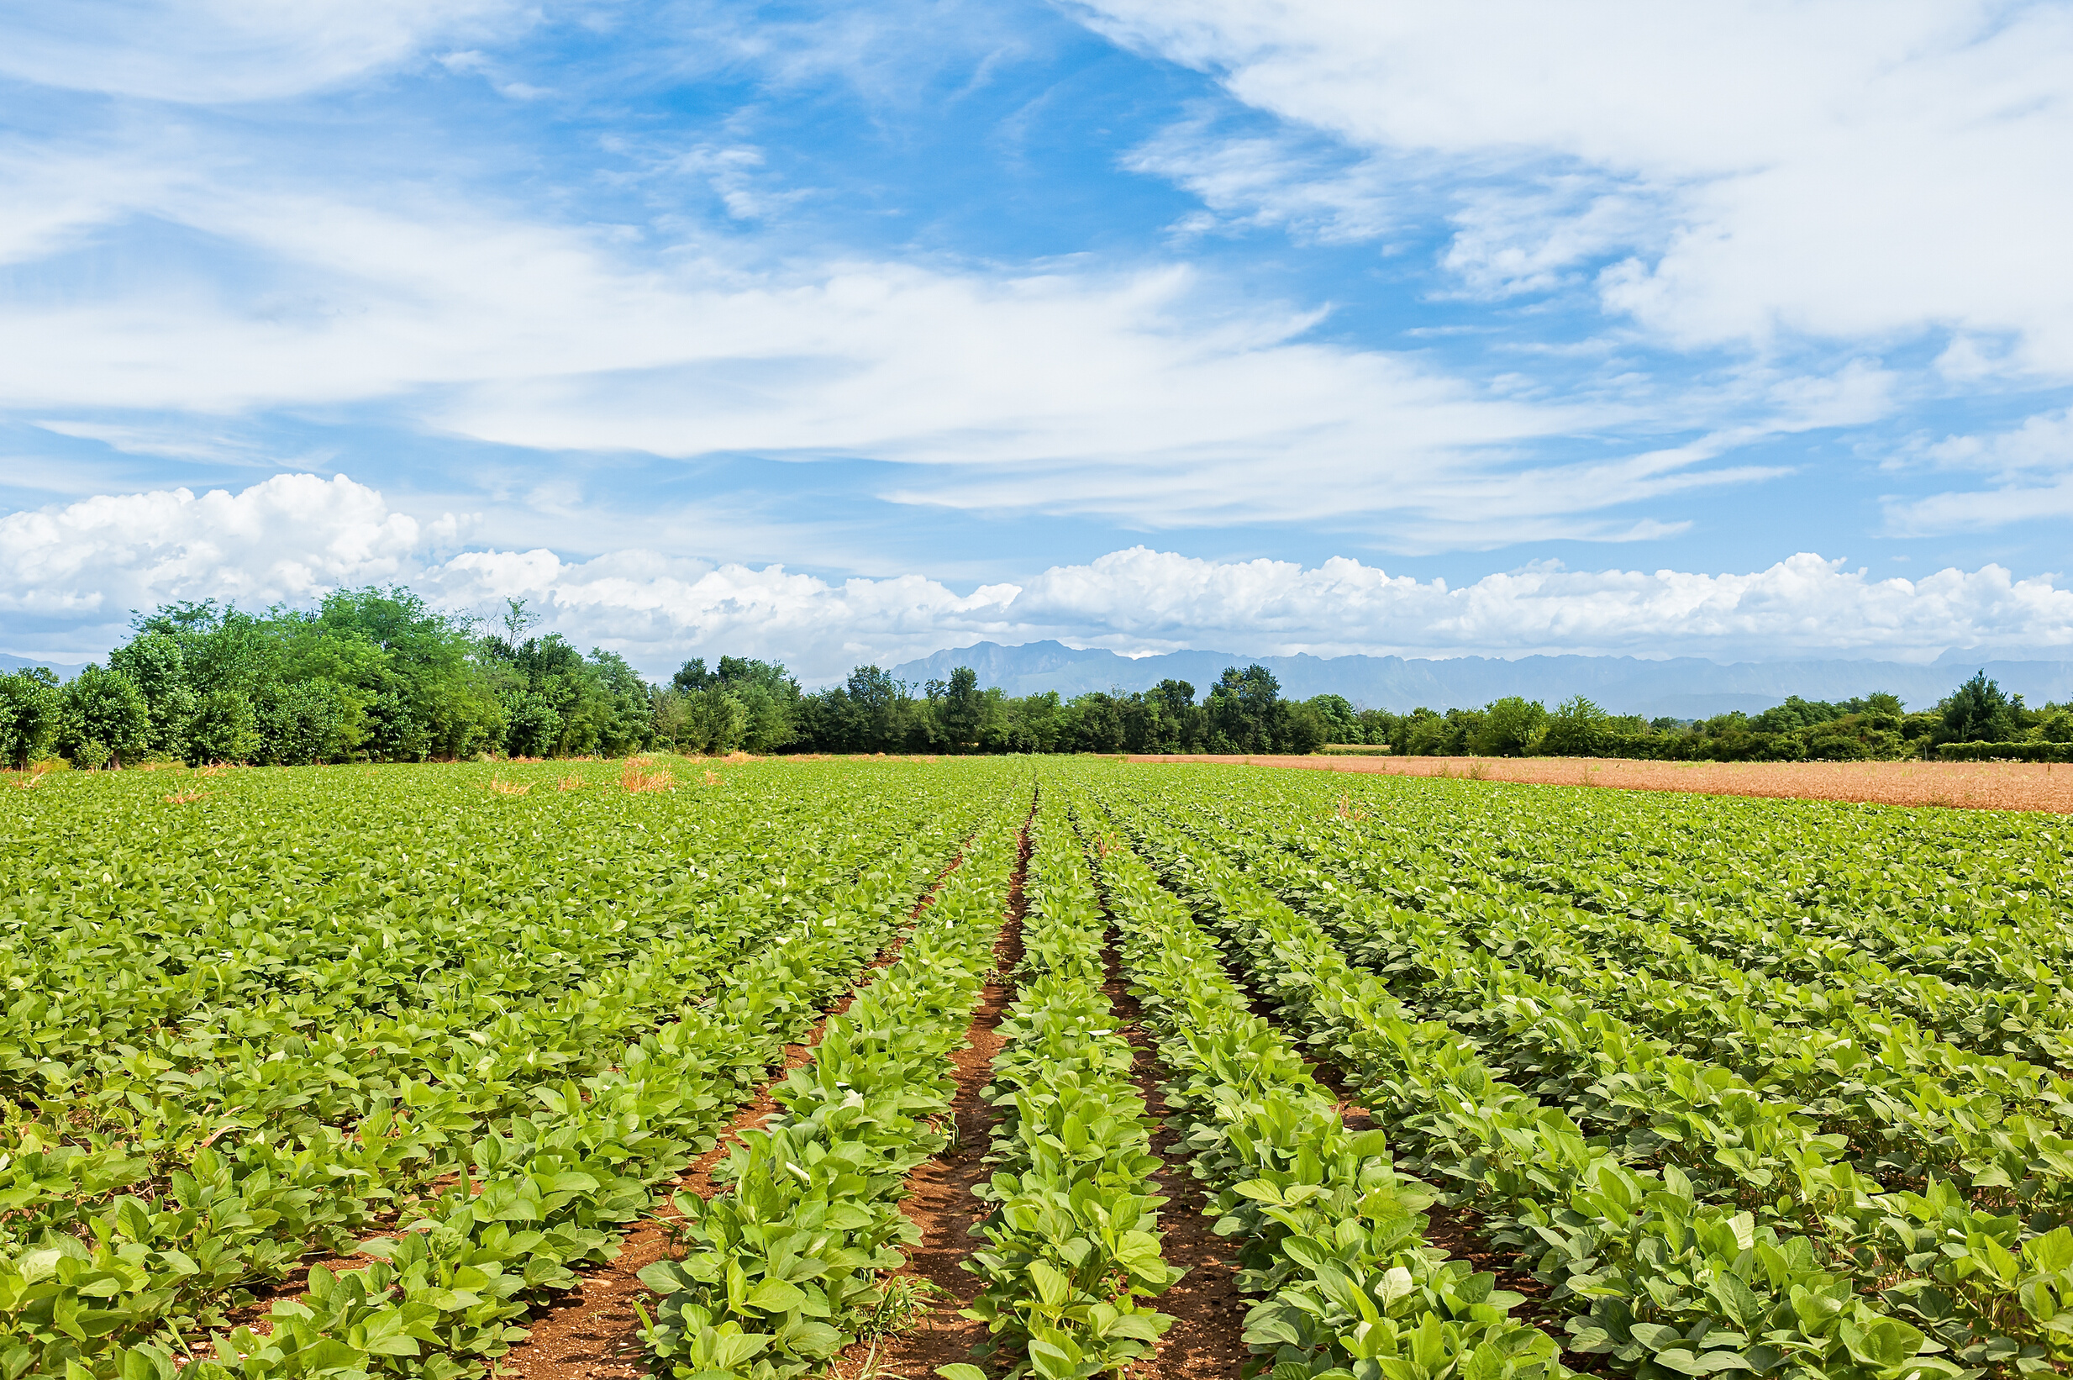
Conclusion
In summary, this project has effectively achieved its objectives by thoroughly exploring and analyzing district-wise and year-wise agricultural data in India. Through comprehensive data exploration, we gained insights into the distribution of agricultural variables, identified trends in major crops such as rice, wheat, and pulses, and highlighted regional disparities and seasonal patterns. Furthermore, we investigated the impact of external factors like weather conditions on crop performance and examined the cultivation trends of fruits and vegetables.

Slide 14
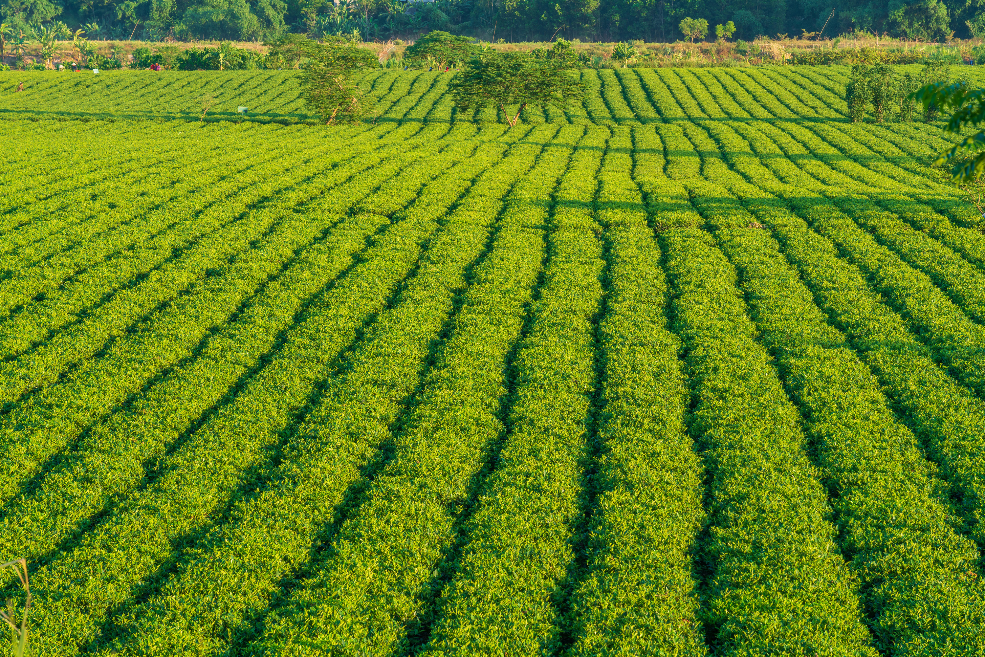

29/03/2024
THANKS

